Slide 1
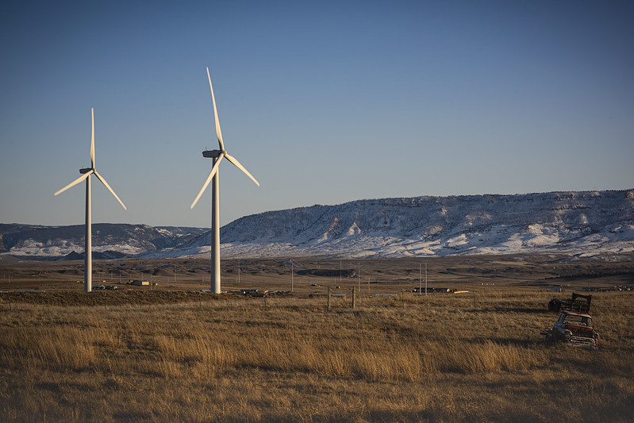
inflation reduction act
May 2023

Slide 2
Overview
The Inflation Reduction Act (IRA) makes historic investments in climate action that are expected to reduce U.S. emissions ~40% by 2030 while supporting disadvantaged communities and the clean energy industrial base.
IRA investments will drive significant emissions reductions over the next decade while also laying the groundwork for long-term decarbonization of hard-to-abate sectors.
EPA will play a major role in delivering these programs. The Agency received $41.5 billion in appropriated funds and expects to receive an additional $11.7 billion in future revenue from reinstating the Superfund Tax on oil and gas production.

Slide 3
Breakdown of Climate & Energy Funding
Total Climate and Energy Funding ($, billions)
Significant support for the electricity sector (e.g., Production & Investment Tax Credits), manufacturing, energy efficiency, electric vehicles, low carbon fuels.¹
Tax Credits
Includes $41.5 billion in appropriated spending and $11.7 billion in new Superfund tax revenue.
EPA
At least 15 other agencies received appropriated funding in the legislation. USDA and DOE were the other two major recipients.
Other agencies that received over $1B in appropriations include:
Department of the Interior ($6.7B)
Department of Transportation ($5.4B)
General Services Administrator ($3.4B)
Department of Commerce ($3.3B)
U.S. Postal Service ($3B) ← Electric postal trucks!
Housing and Urban Development Agency ($1B)
U.S. Department
of Agriculture
Department
of Energy
Other Agencies
1. Preliminary Joint Committee on Taxation analysis. Further CBO projections pending.
Source: Senate Democrats, Joint Committee on Taxation, CBO

Slide 4
EPA Programs
EPA received $41.5 billion in appropriations to support 24 new and existing programs. This makes EPA the second largest recipient of discretionary funding after the U.S. Department of Agriculture.
Six new EPA programs account for 98% of this total funding:
Greenhouse Gas Reduction Fund ($27 billion) – Provide capital to greenhouse gas mitigation projects not currently able to access private capital, particularly in low-income and disadvantaged communities.
Climate Pollution Reduction Grants ($5 billion) – Provide grants at the state, local, and Tribal level to develop plans to reduce greenhouse gas emissions and implement those plans. At least one grant will go to an eligible entity in every state.
Environmental and Climate Justice Block Grants ($3 billion) – Fund community-based nonprofit organizations to support a wide range of climate and environmental justice activities.
Reduce Air Pollution at Ports ($3 billion) – Award rebates and grants for ports to purchase and install zero-emission technology and develop climate action plans.
Methane Emissions Reduction Program ($1.55 billion) – Fund grants and technical assistance to accelerate emissions reduction from petroleum and natural gas systems. Also establish a methane waste emissions charge starting at $900 per ton in 2024 and increasing to $1,500 per ton by 2026.
Clean Heavy-Duty Vehicles ($1 billion) – Provide grants, rebates, and contract support to replace heavy duty vehicles with zero emission alternatives. $400 million is specifically for nonattainment areas.

Slide 5
ADDITIONAL programs total $906 million
National Program Office and Program | Funding ($)
Office of Air (OAR) | 491,000,000
Funding to Address Air Pollution - Fenceline Air Monitoring & Screening Air Monitoring | 235,500,000
Low Emissions Electricity Program | 87,000,000
Diesel Emissions Reductions | 60,000,000
Funding to Address Air Pollution at Schools | 50,000,000
Funding for Implementation of the American Innovation & Manufacturing Act on HFCs | 38,500,000
Funding for Section 211(o) of the Clean Air Act (Renewable Fuels) | 15,000,000
Greenhouse Gas Corporate Reporting | 5,000,000
Office of Chemical Safety and Pollution Prevention (OCSPP) | 350,000,000
Environmental Product Declaration Assistance | 250,000,000
Low-Embodied Carbon Labeling for Construction Materials | 100,000,000
Permitting (Multiple Offices) | 40,000,000
Efficient, Accurate, and Timely Permitting Reviews | 40,000,000
Office of Enforcement and Compliance Assurance (OECA) | 25,000,000
Funding for Enforcement Technology & Public Information | 25,000,000
KEY TAKEAWAYS
Many of these programs build on existing programs and can proceed quickly through established relationships with state, local, and tribal partners.
OCSPP’s embodied carbon programs will inform other infrastructure projects such as roads, bridges, and ports.
A major investment in permitting will bolster EPA’s capacity to provide quality, timely environmental reviews and permitting for critical projects.

Slide 6
The Greenhouse gas reduction fund (ggrf) has three program objectives
ADDITIONAL INFORMATION IN IMPLEMENTATION FRAMEWORK DOCUMENT ON EPA.GOV/GGRF
The three Greenhouse Gas Reduction Fund program objectives
Reduce emissions of greenhouse gases and other air pollutants
Deliver benefits to American communities—especially low-income and disadvantaged communities
Mobilize financing and private capital to stimulate additional deployment
Tackle the climate crisis and protect public health by supporting the climate goals of the United States to reduce greenhouse gas emissions 50-52 percent below 2005 levels in 2030 and achieve net-zero emissions by no later than 2050
Maximize the benefits of GGRF investments to Americans; every GGRF competition will align with the President’s Justice40 requirements, ensuring that 40% of the overall benefits from a program flow to disadvantaged communities
Catalyze market transformation by addressing the barriers to mobilizing private capital into clean projects in undercapitalized markets and facilitating tens of thousands of clean technology projects that deliver tangible benefits to millions of American households
https://www.epa.gov/inflation-reduction-act/greenhouse-gas-reduction-fund

Slide 7
To achieve these three objectives, the GGRF Program will run three grant competitions
ADDITIONAL INFORMATION IN IMPLEMENTATION FRAMEWORK DOCUMENT ON EPA.GOV/GGRF
Overview of the Greenhouse Gas Reduction Fund competition structure
National Clean Investment Fund
Clean Communities Investment Accelerator
Solar for All
Competition description
Fund 2-3 national nonprofits to partner with private capital providers to deliver financing at scale catalyzing tens of thousands of clean technology projects
Fund hub nonprofits to rapidly build clean financing capacity of networks of community lenders to finance pollution-reducing projects in low-income & disadvantaged communities
Support states, territories, Tribal & municipal governments, & nonprofits to expand access to solar for low-income & disadvantaged communities by priming markets for investment
Number and type of grantees
2-3 national nonprofits
2-7 hub nonprofits
Up to 60 states, Tribal & municipal governments, & eligible non-profit entities
Funding available
Nearly $14B
$6B
$7B
Expected impacts
Historic public sector investment with the scale to attract private capital leverage in clean projects, supporting the 2030, 2035, & 2050 climate goals of the United States and catalyzing tens of thousands of clean technology projects
Robust pipeline of thousands of community-led clean projects with meaningful benefits, generated by hundreds of community lenders capitalized by GGRF to start or expand clean lending in underserved communities
Energy bill savings and energy resiliency for millions of underserved American households via states, Tribal & municipal governments, & other recipients creating new or expanding existing low-income solar programs across the country

Slide 8
Climate Pollution Reduction Grants
$250 million for Climate Pollution Reduction (CPRG) Planning Grants with at least one grant to an eligible entity in every state; noncompetitive.
Eligible entities: States, air agencies, municipalities, Tribes, or combinations
Arizona has applied; Maricopa Association of Governments (Phoenix) and Pima County DEQ (Tucson) are preparing their applications
Plans shall include programs, policies, measures, and projects that will achieve or facilitate the reduction of greenhouse gas air pollution.
$4.6 billion for competitive CPRG Implementation Grants. Activities must be covered in a plan developed with funding from a CPRG planning grant.
www.epa.gov/inflation-reduction-act/climate-pollution-reduction-grants

Slide 9
Environmental and climate justice block grants
$2.8 billion to provide environmental and climate justice block grants for activities benefiting disadvantaged communities.
$200 million for technical assistance.
Request for Information closed on April 10, 2023
Seeking Input on:
ECJ Program Design
Types of Projects to Fund
Reducing Application Barriers
Reporting and Oversight
Technical Assistance
https://www.epa.gov/inflation-reduction-act/inflation-reduction-act-environmental-and-climate-justice-program

Slide 10
Mobile source programs overview
Clean Heavy-Duty Vehicles: $1B for zero-emission vehicles, infrastructure, and workforce development.
Ports: $3B for zero-emission port equipment, related planning and permitting, or to develop climate action plans
For both of the above programs, Request For Information (RFI) open until June 5, 2023.
https://www.epa.gov/inflation-reduction-act/clean-heavy-duty-vehicle-program
https://www.epa.gov/inflation-reduction-act/clean-ports-program

Slide 11
Methane emissions program overview
Petroleum and Natural Gas Systems
$850 million for incentives for methane mitigation and monitoring
$700 million for incentives for methane mitigation from marginal conventional wells
Establishes a waste emission charge ($900 to $1,500 per metric ton depending on the year) for emissions greater than 25,000 metric tons CO2e. Begins in 2024
https://www.epa.gov/inflation-reduction-act/methane-emissions-reduction-program

Slide 12
resources
White House Inflation Reduction Act Guidebook:
https://www.whitehouse.gov/cleanenergy/inflation-reduction-act-guidebook/
EPA IRA:
https://www.epa.gov/inflation-reduction-act
https://www.epa.gov/inflation-reduction-act/epa-funding-announcements-bipartisan-infrastructure-law-and-inflation

Slide 13
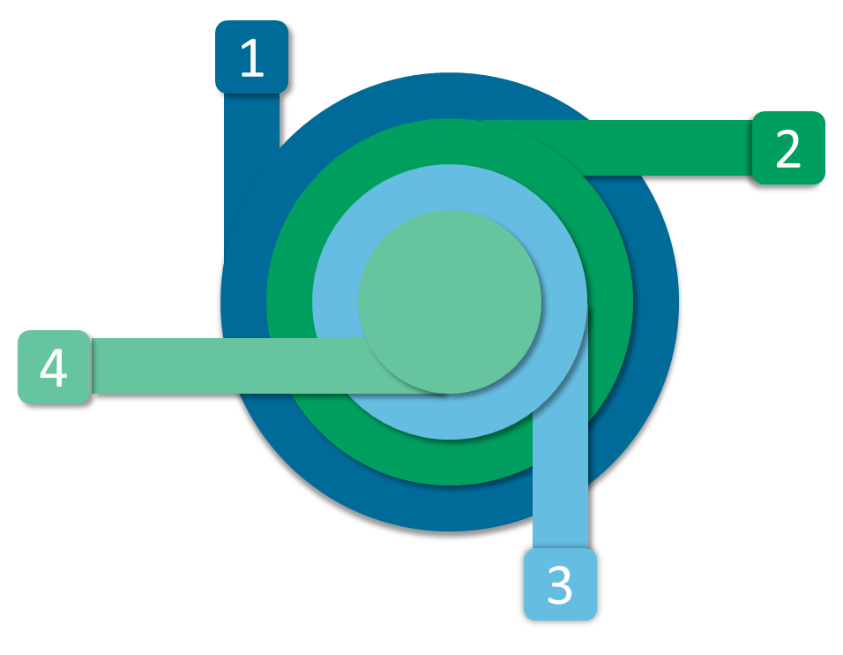
Planning grant allocations
States: $156 million
Up to $3M per state + DC + Puerto Rico
Locals:
$67 million
Territories:
$2 million
Tribes:
$25 million

Slide 14
Planning Grant Application Process
Entity | Notice of Intent to Participate (NOIP) | Application | Award (estimate)
States | March 31, 2023 | April 28, 2023 | Summer 2023
Municipalities | April 28, 2023 | May 31, 2023 | Summer 2023
Territories | N/A | June 15, 2023 | Late Summer 2023
Tribes | Request informal notice by April 28, 2023 | June 15, 2023 | Late Summer 2023
Fall 2023: Announce notice of funding opportunity for the implementation grants, which will be awarded under a competitive process.
Implementation grant applications will be due in first quarter of 2024.

